Slide 1

Diffusion Model By:- Dhwanil Panchani

Slide 2
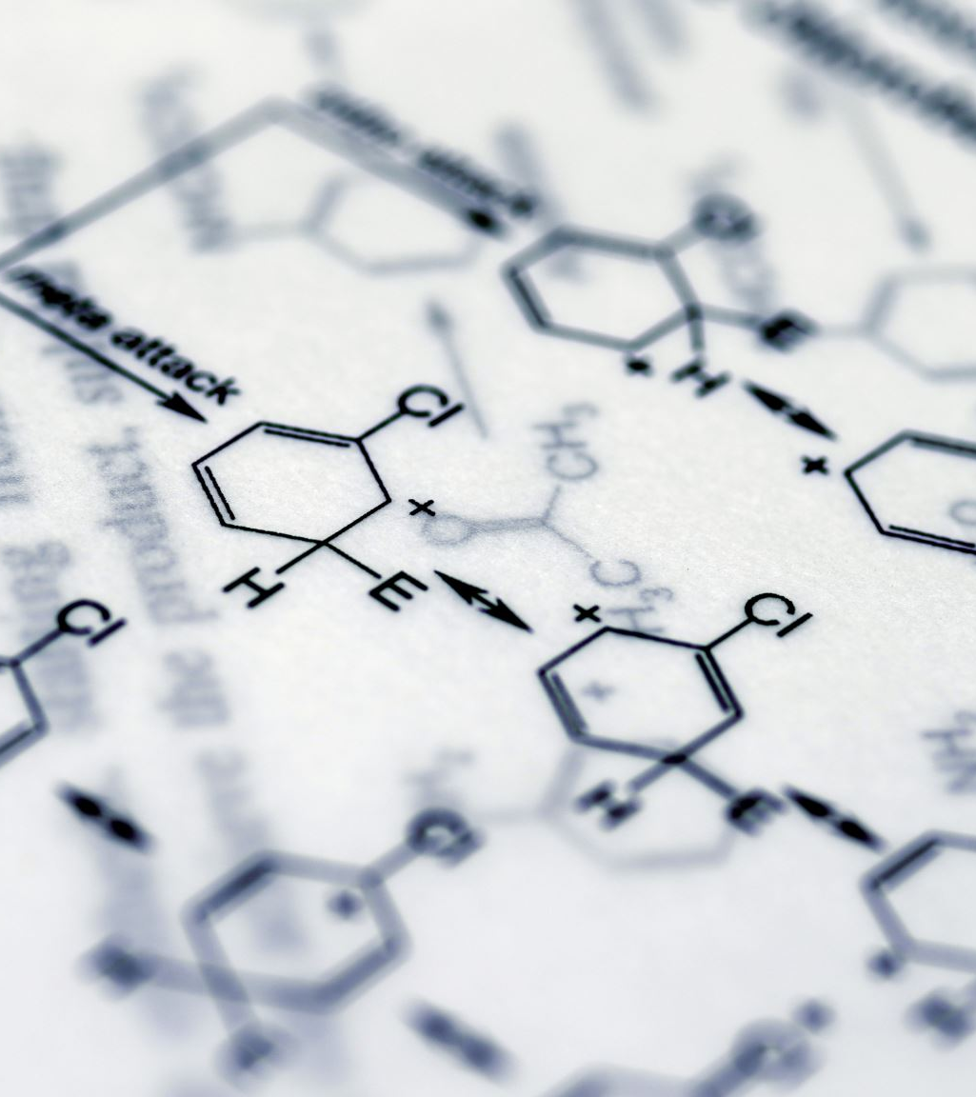
What is diffusion model?
Definition: A diffusion model is a type of generative model that creates data (e.g., images) by reversing a gradual noise addition process.
Key Components:
1. Forward Process:
Gradually adds Gaussian noise to the input data, destroying its structure.
Models a predefined noise schedule.
2. Reverse Process:
Learns to reverse the noise-adding process.
Restores the original data distribution from noisy inputs.

Slide 3
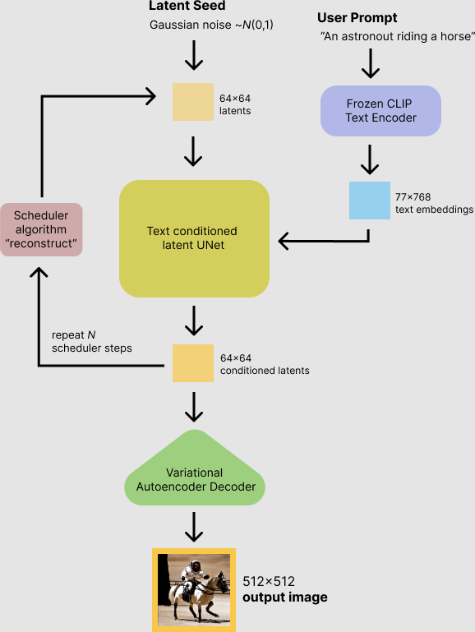
How Does it Work!
1. VAE (Variational Autoencoder) for Latent Space Representation
VAE compresses input data (e.g., images) into a lower-dimensional latent space, making it computationally efficient for diffusion operations.
Noise is progressively added in this latent space during the forward diffusion process.
The reverse process learns to denoise and reconstruct the data back to the latent representation.
2. U-Net for Denoising
U-Net serves as the backbone for the reverse diffusion process, acting as a denoiser.
It uses a hierarchical architecture to capture both local and global context, enabling the generation of fine-grained details.
Each denoising step iteratively refines the noisy latent representation towards a clean image.
3. CLIP for Text-Image Alignment
CLIP generates embeddings for both text and images, ensuring semantic alignment.
During training, the model optimizes to match generated images with corresponding text descriptions in CLIP’s embedding space.
This guides the diffusion model to produce images that are not only visually coherent but also semantically accurate to the given text prompts.

Slide 4
Why Use Diffusion Models?
High-Quality Outputs: Generate detailed and realistic outputs, especially for images.
Stability: Overcomes challenges faced by models like GANs (e.g., mode collapse).
Flexibility: Applicable to various domains, including image synthesis, audio generation, and text-to-image tasks.

Slide 5
Training and Fine-Tuning
Training Process:
CLIP embeddings aligned with VAE’s latent space.
U-Net optimized for high-fidelity image reconstruction.
Fine-Tuning Details:
DataLoader: A DataLoader with image-caption pairs is used for training, with images and captions tokenized and batched for efficient processing.
Model and Training: The model is fine-tuned using AdamW optimizer and cross-entropy loss, computing alignment between image and text embeddings.
Training Loop: Each epoch includes forward passes, loss computation, backpropagation, and weight updates, with average epoch loss logged for monitoring.

Slide 6
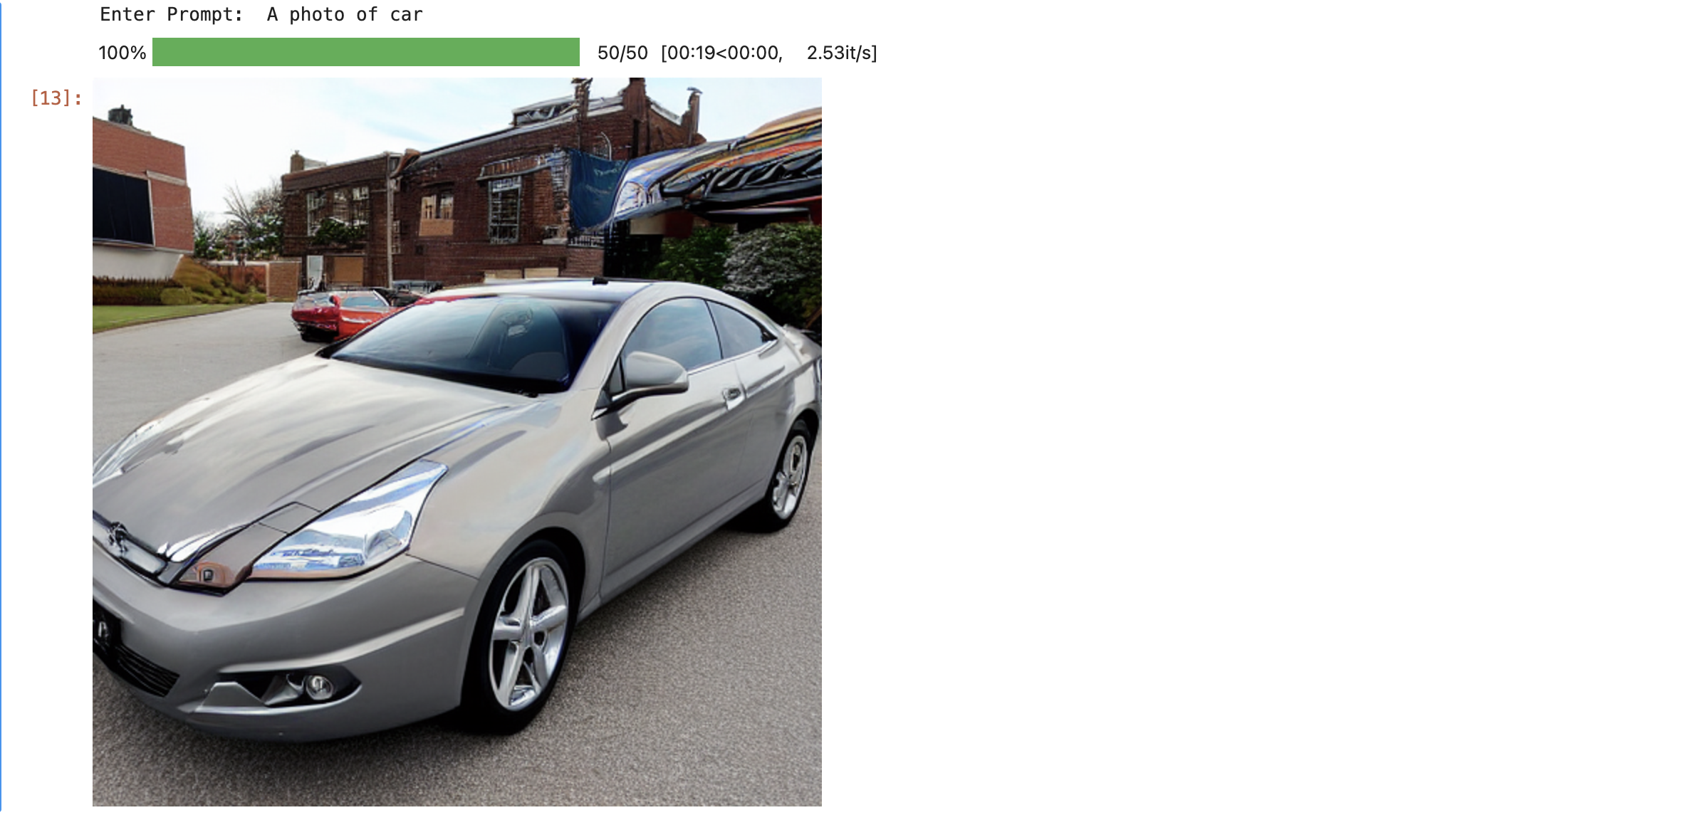
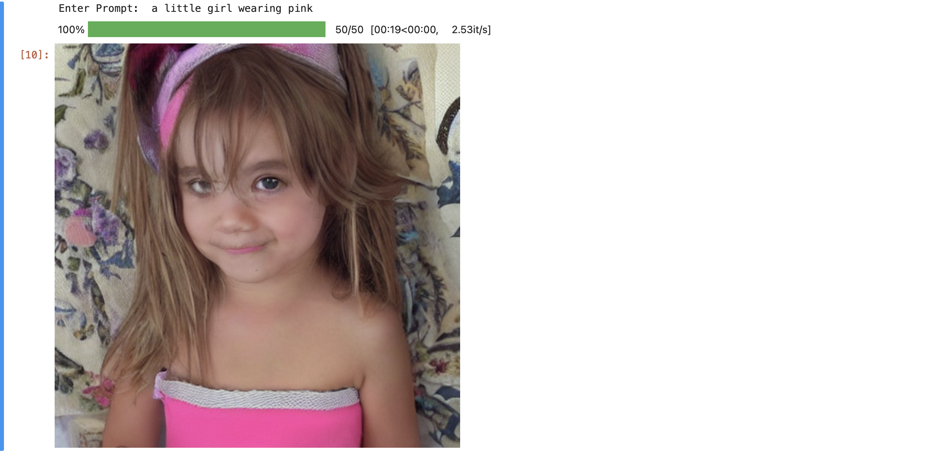
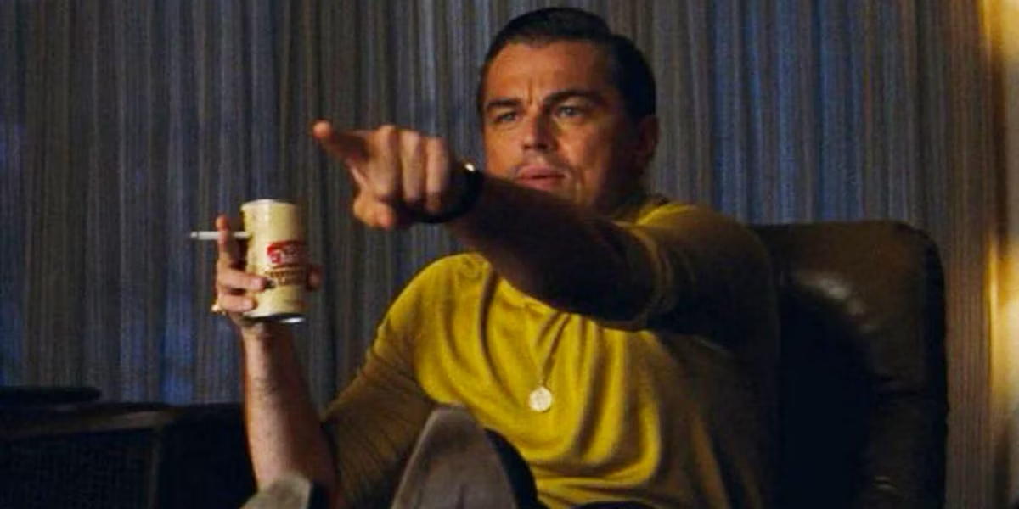
Image generated using different dataset
CIFAR-10(Car)
Flickr8k

Slide 7
Challenges and Observations
Challenges:
Balancing Text-Image Alignment: Ensuring the model maintains semantic consistency between text and image embeddings while adapting to specific datasets.
Overfitting Risks: Fine-tuning on small or domain-specific datasets may lead to loss of generalization.
Computational Overheads: High resource demands for training, particularly when working with large image and text embeddings.
Data Imbalance: Misalignment due to biased or insufficiently diverse datasets.
Observations:
Improved Relevance: Fine-tuning enhances the model’s ability to generate images closely aligned with domain-specific text prompts.
Trade-Offs: Specialized fine-tuning improves domain performance but might reduce general text-to-image versatility.
Importance of Preprocessing: Effective text tokenization and dataset preparation significantly impact fine-tuning success.

Slide 8
Future Directions
Potential Improvements:
Incorporating larger and more diverse datasets.
Experimenting with different architectures for better alignment.
Applications:
Polishing the model for Content creation, creative industries, and assistive tools.
Integration into AR/VR systems.

Slide 9

Thank You

